Slide 1
Views

Slide 2
1.1 Introduction to Android Views
What is the Android UI Framework?
The Android UI framework is a set of classes and tools provided by the Android platform to build user interfaces for Android applications.
It includes a wide range of UI components (Views) and layouts that allow developers to design and implement user interfaces efficiently.
Components of the Android UI Framework
Views: Basic building blocks of the UI, representing visual elements such as text, images, buttons, etc.
ViewGroups: Containers that hold and manage multiple Views or other ViewGroups, controlling their layout and appearance.
Layouts: Special types of ViewGroups that define the positioning and sizing of Views within them.

Slide 3
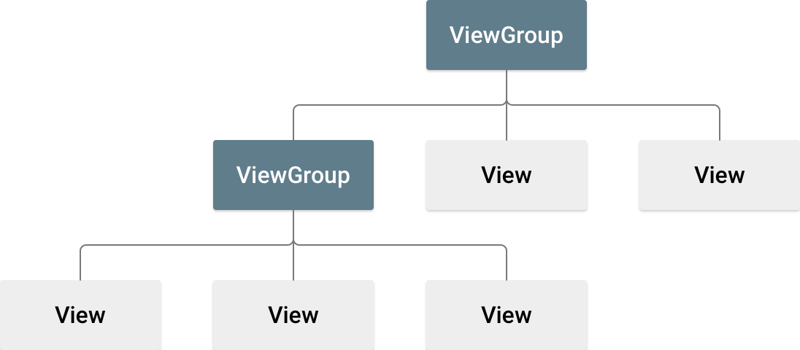

Slide 4
Importance of Views in Android
User Interaction:
Views are the primary means through which users interact with an application. They capture input (e.g., typing in a TextView or clicking a Button) and display information (e.g., showing text or images).
Visual Representation:
Views are responsible for rendering content on the screen. They display various types of data, from simple text and images to complex, interactive elements like forms and lists.
Customization and Flexibility:
Android provides a rich set of built-in Views that can be customized extensively to fit the design and functionality requirements of an application. Developers can also create custom Views for more specific needs.

Slide 5
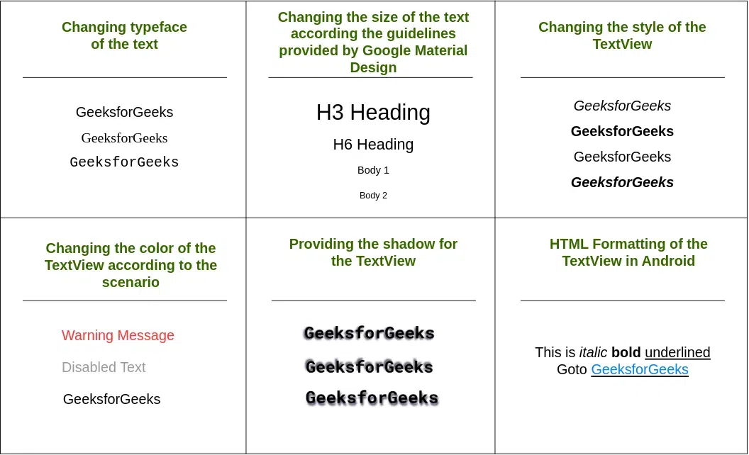

Slide 6
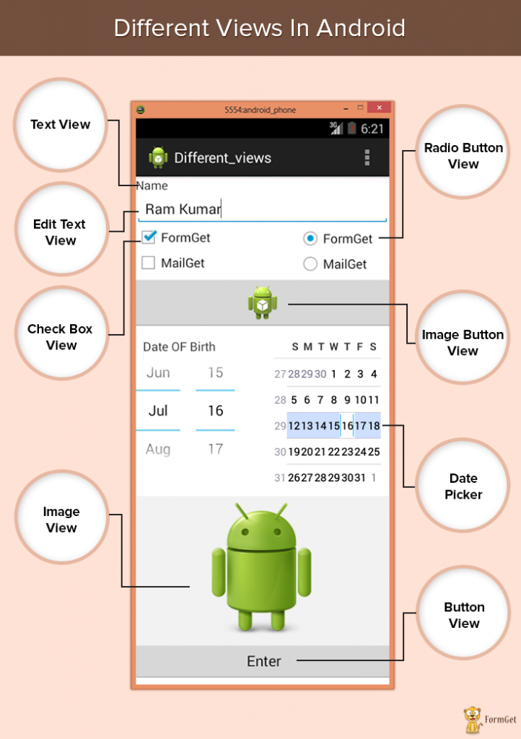

Slide 7
Basic Properties

Slide 8
What are Layouts?
Layouts are ViewGroups that organize and arrange Views on the screen. They define how child Views are positioned and sized relative to each other and the parent container.
Common Layouts in Android:
LinearLayout: Arranges child Views in a single row or column.
RelativeLayout: Positions child Views relative to each other or the parent layout.
ConstraintLayout: A more advanced and flexible layout that allows for positioning and sizing Views with constraints.
FrameLayout: A simple layout that displays a single child View, with additional Views stacked on top of each other.
GridLayout: Arranges child Views in a grid, allowing for complex row and column arrangements.

Slide 9
Link

Slide 10
1. TextView
TextView is a user interface element that displays text to the user. It can be used for static text or text that updates dynamically. It does not allow user interaction for editing the text; it's read-only.
Key Features of TextView:
Text Appearance: You can customize the appearance, including font size, color, style (bold, italic), and more.
HTML Formatting: It can display HTML-formatted text.
Spannable Strings: Supports different styles in different parts of the text (e.g., bold, italic, underlined).
Marquee Effect: Can scroll text horizontally if the text is too long to fit.
Text Alignment and Gravity: Allows alignment of text (left, center, right) and setting the gravity within its bounds.

Slide 11
<TextView
android:id="@+id/textView"
android:layout_width="wrap_content"
android:layout_height="wrap_content"
android:text="Hello, World!"
android:textColor="#000000"
android:textSize="18sp" />

Slide 12
EditText is a subclass of TextView and provides an editable text box that allows users to input and modify text. It is often used for forms, user input fields, and search boxes.
Key Features of EditText:
Input Types: Supports various input types, such as text, number, password, email, etc., to restrict and format the input.
Input Filters: Can set filters to limit the type and number of characters the user can enter.
Hint Text: Displays a hint inside the box when the text field is empty.
ImeOptions: Customizes the appearance and behavior of the keyboard (IME - Input Method Editor) when the user interacts with the EditText.
Text Watchers: Allows monitoring of text changes in real-time, which can be used for form validation or dynamic content updates.

Slide 13
<EditText
android:id="@+id/editText"
android:layout_width="match_parent"
android:layout_height="wrap_content"
android:hint="Enter your name"
android:inputType="textPersonName" />

Slide 14
Types of EditText:
Plain Text (text): Default style, accepts any text input.
Password (textPassword): Masks the input with dots or asterisks for security.
Email (textEmailAddress): Configures the keyboard for email entry, with "@" and "." keys.
Phone (phone): Configures the keyboard for phone number entry.
Number (number): Only allows numerical input.
Date (date): Typically used with date pickers.
Time (time): Used for time input, often with time pickers.
Multiline (textMultiLine): Allows multiple lines of text input.

Slide 15
Differences Between TextView and EditText:
TextView: Used for displaying read-only text.
EditText: Used for text input and editing.

Slide 16
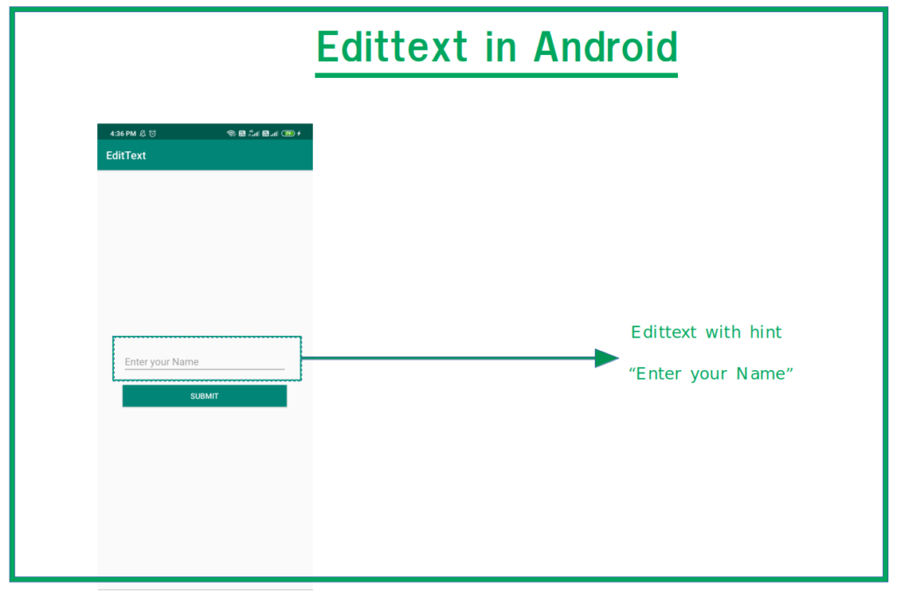

Slide 17
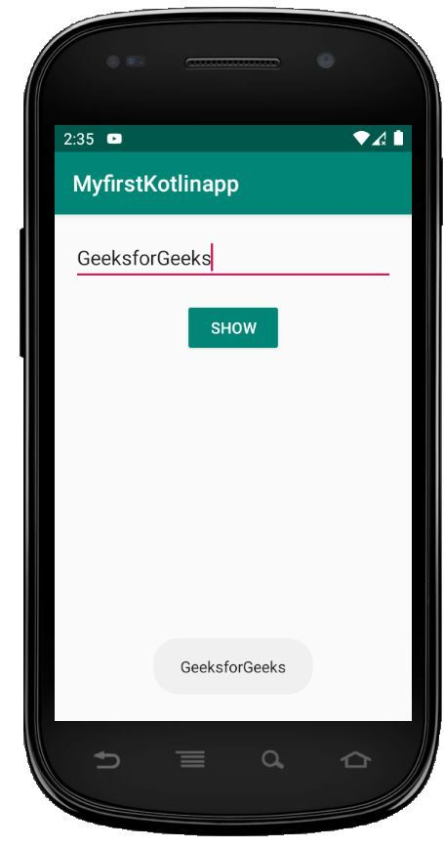

Slide 18
1. Button
The basic Button widget in Android is a rectangular button that responds to user clicks or taps. It can display text and/or an icon and can trigger an action when clicked.
Key Features:
Text and Icon: Buttons can display both text and an icon, allowing for a combination of visual and textual cues.
Clickable: It responds to user interactions, triggering events defined in the code.
Customizable Appearance: You can style buttons with custom backgrounds, colors, shapes, and more.

Slide 19
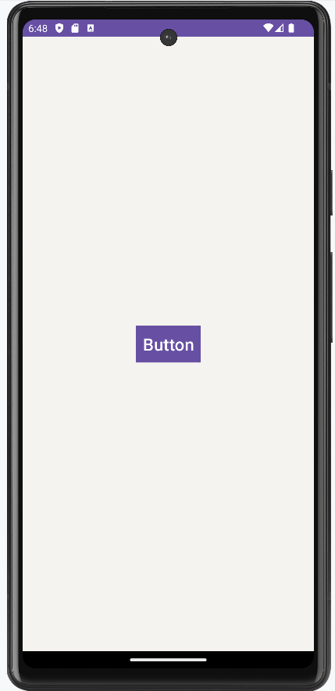

Slide 20
<Button
android:id="@+id/button"
android:layout_width="wrap_content"
android:layout_height="wrap_content"
android:text="Click Me" />

Slide 21
Handling Click Events:
To handle button clicks, you can set an OnClickListener in the activity or fragment's code:
Button button = findViewById(R.id.button);
button.setOnClickListener(new View.OnClickListener() {
@Override
public void onClick(View v) {
// Handle button click
}
});

Slide 22
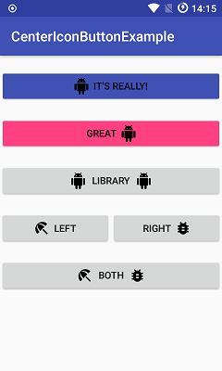
2. ImageButton
An ImageButton is similar to a standard Button but uses an image as its content instead of text. It's useful for icons and graphic-based buttons.
<ImageButton
android:id="@+id/imageButton"
android:layout_width="wrap_content"
android:layout_height="wrap_content"
android:src="@drawable/icon" />

Slide 23
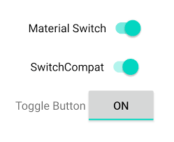
3. ToggleButton
A ToggleButton is a two-state button that can be either "on" or "off." It is commonly used to represent a binary state, such as enabling or disabling a setting.

Slide 24
<ToggleButton
android:id="@+id/toggleButton"
android:layout_width="wrap_content"
android:layout_height="wrap_content"
android:textOn="ON"
android:textOff="OFF" />

Slide 25
4. RadioButton
RadioButton is a part of a group where only one button can be selected at a time. It is typically used for selecting one option from a set of mutually exclusive choices.

Slide 26
<RadioGroup
android:layout_width="wrap_content"
android:layout_height="wrap_content">
<RadioButton
android:id="@+id/radioButton1"
android:layout_width="wrap_content"
android:layout_height="wrap_content"
android:text="Option 1" />
<RadioButton
android:id="@+id/radioButton2"
android:layout_width="wrap_content"
android:layout_height="wrap_content"
android:text="Option 2" />
</RadioGroup>

Slide 27
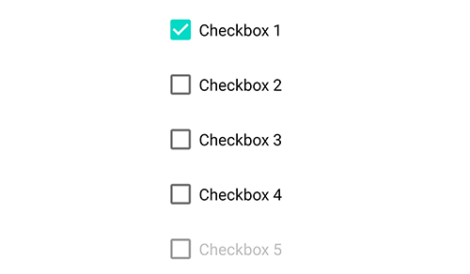
5. CheckBox
CheckBox is a two-state button that can be either checked or unchecked. Unlike RadioButton, multiple checkboxes can be checked at the same time. It is often used in forms where multiple options can be selected.

Slide 28
<CheckBox
android:id="@+id/checkBox"
android:layout_width="wrap_content"
android:layout_height="wrap_content"
android:text="Accept Terms and Conditions" />

Slide 29
6. FloatingActionButton (FAB)
FloatingActionButton is a circular button that floats above the UI and is usually placed at a prominent location on the screen. It is often used for primary actions, such as creating new content.
<com.google.android.material.floatingactionbutton.FloatingActionButton
android:id="@+id/fab"
android:layout_width="wrap_content"
android:layout_height="wrap_content"
android:src="@drawable/ic_add"
android:contentDescription="Add new item" />

Slide 30
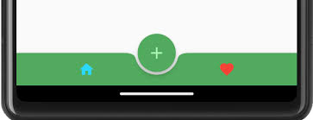

Slide 31
Spinner
In Android development, a Spinner is a UI widget that provides a way to select one item from a dropdown menu. It is similar to a combo box in other programming environments. The Spinner displays the currently selected item and, when clicked, presents a list of options for the user to choose from.
Key Features of Spinner:
Dropdown Menu: Displays a dropdown list of items for selection.
Single Selection: Allows the user to select only one item at a time.
Customizable Appearance: Can be styled and customized to match the app's design.

Slide 32
